Slide 1

Systematic Literature Review of [Free and] Open source hardware
ECE 1785 / CSC 2130 – Emperical SE
Group 17
Ali Raeisdanaei
Jingyue Zhang
Tiantian Lin
Ziqian Qiu

Slide 2
AGENDA – in 6 minutes
Motivation
Research Questions
Study Method
Anticipated Results

Slide 3
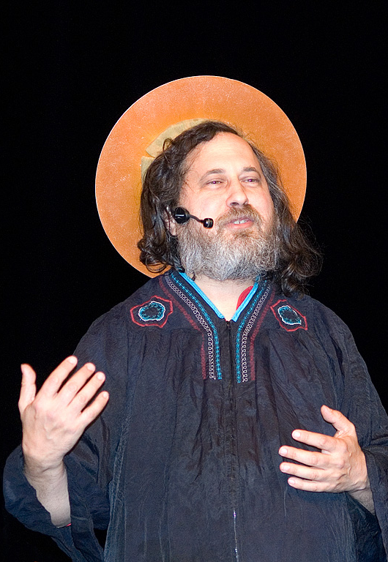
Motivation: FOSS (Free & Open Source Software)
Founded by Software Engineer, …
Richard Matthew Stallman (RMS)
Four Principles1:
The freedom to run the program
The freedom to study and change program
The freedom to redistribute program
The freedom to distribute modified program
[1] Richard Stallman. Free software free society: Selected essays of Richard M. Stallman. Vol. 3. Free Software Foundation, 2015

Slide 4


Hardware Challenge
FOSS has been a great success
Hardware has always been a challenge

Slide 5
Hardware Solution?
Surge of interest into “ Open Source Hardware (OSH)”
Community built hardware
Commercially available hardware
Open Source Hardware Association
Surge in Research Literature
Two Journals since 2017
Journal of Open Hardware
HardwareX

Slide 6
Our Research
How “free” is [F]OSH
What are the types of licenses that the OSH are using?
How does it compare
What is the state-of-the art FOSH? What are its technical specifications compared to nonFOSH?
What are the main challenges with the development, adoption, and sustainability of FOSH?
What does (or should) its future look like

Slide 7
Study Methodology
Systematic Literature Review
Comb through of
Journal of Open Hardware
HardwareX
Since 2017 inception
Commercial and community applications
Projects tracked by the Open Source Hardware Association

Slide 8
Anticipated Results
We found N hardware of C categories with these licenses [l1, l2, …,lN]
Comparison of the best FOSH in each category C with the nonFOSH
Main assumption about FOSH:
Specialised & scientific hardware
Explains the challenges of FOSH
Future: missing pieces in the FOSH landscape

Slide 9
Thank YOU Questions & Answers

